Slide 1
Presentation – 2
Training – BlockChain
Presented by:
Chirantan Ganguly
Sagnik Nayak

Slide 2
Topics
What is Blockchain?
Cryptographic Links (Hash functions)
Immutable Ledger
Distributed P2P network
How Mining Works?
Byzantine Fault Tolerance
Consensus Protocols
  Proof-of-Work (Bitcoin)
  Proof-of-Stake (Ethereum)

Slide 3
What is a Blockchain?
A blockchain is a continuously growing list of
records, called blocks which are linked and
secured using cryptography.
- Wikipedia

Slide 4
What constitutes a Block?
1. Data: “Hello World!”
}
2. Prev. Hash: 034DFA357
From SHA algorithms (SHA256)
3. Hash: 4D56E1F05

Slide 5

Chain of Blocks
Genesis Block
1
2
3
1. Data: …
1. Data: …
1. Data: …
2. Prev. Hash: 000000000
2. Prev. Hash: 034DFA357
2. Prev. Hash: 4D56E1F05
3. Hash: 034DFA357
3. Hash: 4D56E1F05
3. Hash: 7364AEB2F
“Blocks are cryptographically linked together”

Slide 6
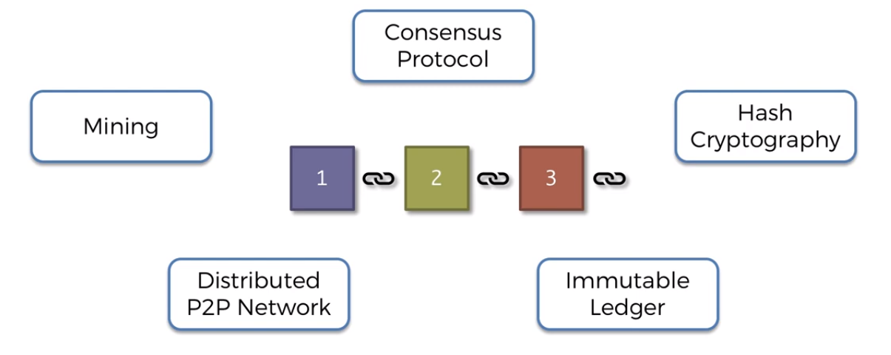



Slide 7






Immutable Ledger
Buying a House
Traditional Ledger:
Blockchain:

Slide 8

Immutable Ledger
Buying a House
Traditional Ledger
Blockchain:

Slide 9
Immutable Ledger
Buying a House
Traditional Ledger
Blockchain:

Slide 11
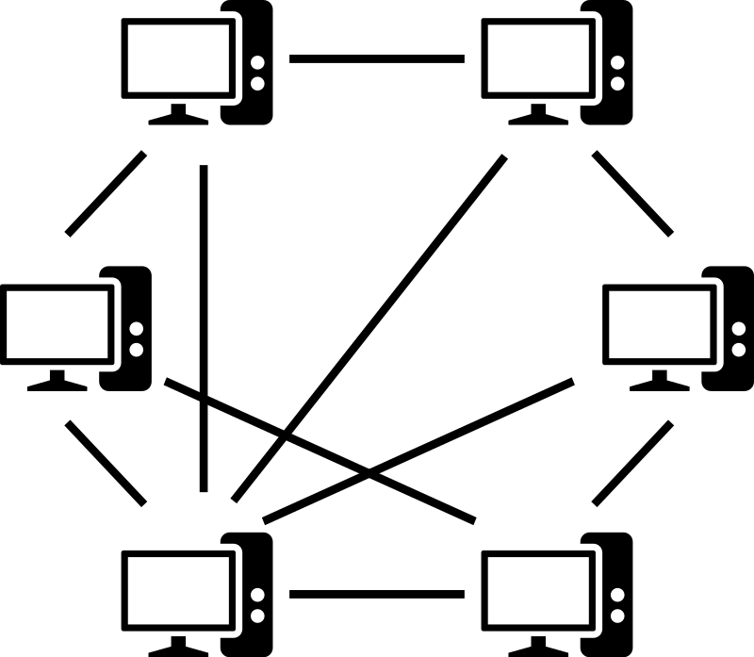
Distributed P2P network

Slide 12
Distributed P2P network

Slide 13
Distributed P2P network

Slide 14
Distributed P2P network

Slide 15
Distributed P2P network

Slide 16
Distributed P2P network

Slide 17
Distributed P2P network
In order to corrupt/attack data in a distributed P2P network, all the blocks stored in more than 50% of the participating nodes has to be created (which is practically impossible to do).
No one node can change the chain. (It must be done by consensus of 50%+ nodes – bringing in trust in a trustless network)
This therefore makes Blockchain technology an extremely secure way of record keeping and asset management. (already being used in NFTs)

Slide 19
How Mining Works
Block: #3
Data: Ram -> Shyam 500 xcoins Ram -> Ebay 100 xcoins Hari -> Ahmed 70 xcoins
Prev Hash.: 0000DF2E57FB432A
Hash: 38CE7AFBEA54EA78

Slide 20
How Mining Works
Block: #3
Nonce:
Data: Ram -> Shyam 500 xcoins Ram -> Ebay 100 xcoins Hari -> Ahmed 70 xcoins
Prev Hash.: 0000DF2E57FB432A
Hash: 38CE7AFBEA54EA78
“A nonce is an arbitrary number that can be used just once in a cryptographic communication.
It is often a random or pseudo-random number issued in an authentication protocol to ensure
that old communications cannot be reused in replay attacks”
- Wikipedia

Slide 21
How Mining Works
Block: #3
Nonce: 1
Data: Ram -> Shyam 500 xcoins Ram -> Ebay 100 xcoins Hari -> Ahmed 70 xcoins
Prev Hash.: 0000DF2E57FB432A
Hash: 2578E4F69FB4BDC8

Slide 22
How Mining Works
Block: #3
Nonce: 2
Data: Ram -> Shyam 500 xcoins Ram -> Ebay 100 xcoins Hari -> Ahmed 70 xcoins
Prev Hash.: 0000DF2E57FB432A
Hash: 298AC673A46E5DDE

Slide 23
How Mining Works
Block: #3
Nonce: 3
Data: Ram -> Shyam 500 xcoins Ram -> Ebay 100 xcoins Hari -> Ahmed 70 xcoins
Prev Hash.: 0000DF2E57FB432A
Hash: 3A7455BD3888F4B6

Slide 24
How Mining Works
Block: #3
Nonce: 27
Data: Ram -> Shyam 500 xcoins Ram -> Ebay 100 xcoins Hari -> Ahmed 70 xcoins
Prev Hash.: 0000DF2E57FB432A
Hash: 5219B17581903469

Slide 25
How Mining Works
Block: #3
Nonce: 256
Data: Ram -> Shyam 500 xcoins Ram -> Ebay 100 xcoins Hari -> Ahmed 70 xcoins
Prev Hash.: 0000DF2E57FB432A
Hash: 3C384413C7D460AE

Slide 26
How Mining Works
A hash is a number
2578e4f69fb4bdc8fccbefc49e045e4ef9240e7f0eb626f3cda38b271139e9dd
= 16949177292487217910253228488731172358172970782935
274543986800783681448962525
0000000000000000fccbefc49e045e4ef9240e7f0eb626f3cda38b271139e9dd
= 619855526581861717281142404382745150509121306993258
5150941
0000000000000000000000000000004ef9240e7f0eb626f3cda38b271139e9dd
= 26873189607490815545309822937825948592605

Slide 27
How Mining Works
- ALL POSSIBLE HASHES -
LARGEST
2578e4f69fb4bdc8fccbefc49e045e4ef9240e7f0eb626f3cda38b271139e9dd
= 16949177292487217910253228488731172358172970782935
274543986800783681448962525
0000000000000000fccbefc49e045e4ef9240e7f0eb626f3cda38b271139e9dd
= 619855526581861717281142404382745150509121306993258
5150941
0000000000000000000000000000004ef9240e7f0eb626f3cda38b271139e9dd
= 26873189607490815545309822937825948592605
SMALLEST

Slide 28
How Mining Works
- ALL POSSIBLE HASHES -
LARGEST
2578e4f69fb4bdc8fccbefc49e045e4ef9240e7f0eb626f3cda38b271139e9dd
0000000000000000fccbefc49e045e4ef9240e7f0eb626f3cda38b271139e9dd
0000000000000000000000000000004ef9240e7f0eb626f3cda38b271139e9dd
TARGET
TARGET can be expressed with the leading Zeros
Eg: ‘0000’
SMALLEST

Slide 29
How Mining Works
- ALL POSSIBLE HASHES -
Block: #3
Nonce: 23
Data: Ram -> Shyam 500 xcoins Ram -> Ebay 100 xcoins Hari -> Ahmed 70 xcoins
Prev Hash.: 0000DF2E57FB432A
Hash: F52F23BD0726B81B
LARGEST
Nonce =23
TARGET (0000)
SMALLEST

Slide 30
How Mining Works
- ALL POSSIBLE HASHES -
Block: #3
Nonce: 22
Data: Ram -> Shyam 500 xcoins Ram -> Ebay 100 xcoins Hari -> Ahmed 70 xcoins
Prev Hash.: 0000DF2E57FB432A
Hash: 7BF140DDBEE8F8AA
LARGEST
Nonce =23
Nonce =22
TARGET (0000)
SMALLEST

Slide 31
How Mining Works
- ALL POSSIBLE HASHES -
Block: #3
Nonce: 21
Data: Ram -> Shyam 500 xcoins Ram -> Ebay 100 xcoins Hari -> Ahmed 70 xcoins
Prev Hash.: 0000DF2E57FB432A
Hash: 69E46D14AF93886C
LARGEST
Nonce =23
Nonce =22
Nonce =21
TARGET (0000)
SMALLEST

Slide 32
How Mining Works
- ALL POSSIBLE HASHES -
Block: #3
Nonce: 18
Data: Ram -> Shyam 500 xcoins Ram -> Ebay 100 xcoins Hari -> Ahmed 70 xcoins
Prev Hash.: 0000DF2E57FB432A
Hash: 9A587E4B0E530901
LARGEST
Nonce =23
Nonce =18
Nonce =22
Nonce =21
TARGET (0000)
SMALLEST

Slide 33
How Mining Works
- ALL POSSIBLE HASHES -
Block: #3
Nonce: 143
Data: Ram -> Shyam 500 xcoins Ram -> Ebay 100 xcoins Hari -> Ahmed 70 xcoins
Prev Hash.: 0000DF2E57FB432A
Hash: 52187ACD4E751245
LARGEST
Nonce =23
Nonce =18
Nonce =22
Nonce =21
Nonce =143
TARGET (0000)
SMALLEST

Slide 34
How Mining Works
- ALL POSSIBLE HASHES -
Block: #3
Nonce: 76941
Data: Ram -> Shyam 500 xcoins Ram -> Ebay 100 xcoins Hari -> Ahmed 70 xcoins
Prev Hash.: 0000DF2E57FB432A
Hash: 0004F5E2CC268754
LARGEST
Nonce =23
Nonce =18
Nonce =22
Nonce =21
Nonce =143
Nonce =76941
TARGET (0000)
SMALLEST

Slide 35

How Mining Works
- ALL POSSIBLE HASHES -
Block: #3
Nonce: 5012
Data: Ram -> Shyam 500 xcoins Ram -> Ebay 100 xcoins Hari -> Ahmed 70 xcoins
Prev Hash.: 0000DF2E57FB432A
Hash: 0000982A5F76D3EB
LARGEST
Nonce =23
Nonce =18
Nonce =22
Nonce =21
Nonce =143
Nonce =76941
TARGET (0000)
When hash < Target – Block is added to the chain, and miner is rewarded
Nonce = 5012
SMALLEST

Slide 36





Byzantine Fault Tolerance

Slide 37
Conditions for the attack
Consensus must be reached between the generals of different divisions of the Byzantine army before they attack the castle.
If a majority of the generals decide to attack the castle – then they will attack (Majority Consensus)
If a majority of the generals decide to retreat – then they will retreat (Majority Consensus)
If no consensus is reached between generals of different divisions of the army, it would result in chaos – and they will be attacked.

Slide 38

Byzantine Fault Tolerance

Slide 39
Byzantine Fault Tolerance

Slide 40
Byzantine Fault Tolerance

Slide 41
Byzantine Fault Tolerance

Slide 42
Byzantine Fault Tolerance
In both the above cases the generals (nodes) were able to come to a favorable consensus which will ensure chaos does NOT unfold – and therefore they aren’t defeated.
To what level is this algorithm fault tolerant?
In the above discussed case – if there are 2 traitors – there is no way to succeed. (2 traitors – 50% nodes are traitors)
This kind of fault tolerance protocols (consensus protocols) are required in all decentralized systems.
For the discussed algorithm to work successfully, no. of traitor nodes cannot exceed 33.33% of total number of nodes.

Slide 43


Slide 44
Consensus Protocols

Slide 45
Consensus Protocols
Challenge 1: Attackers

Slide 46
Consensus Protocols
Challenge 2: Competing Chains

Slide 47
Consensus Protocols
Consensus Protocols
Proof-of-Work (PoW)
Proof-of-Stake (PoS)
Others

Slide 48
Consensus Protocols
- ALL POSSIBLE HASHES -
Block: #3
Nonce: 5012
Data: Ram -> Shyam 500 xcoins Ram -> Ebay 100 xcoins Hari -> Ahmed 70 xcoins
Prev Hash.: 0000DF2E57FB432A
Hash: 0000982A5F76D3EB
LARGEST
Nonce =23
Nonce =18
Nonce =22
Nonce =21
Nonce =143
The valid Hash – is the Proof-of-Work
Nonce =76941
TARGET (0000)
When hash < Target – Block is added to the chain, and miner is rewarded
Nonce = 5012
SMALLEST

Slide 49
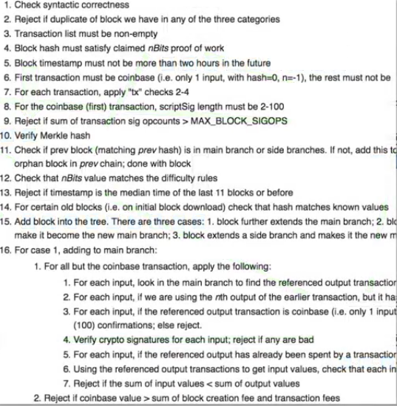
Prevention against attacks (PoW)
Cryptographic Puzzles:
Hard to solve; Easy to verify
Lot of work is done and resources are spent by the attacker to include the block

Slide 50
Problem of Competing Chains (PoW)
Wait for the next block to be added.
Longer Chain is king.

Slide 51

Problem of Competing Chains (PoW)
Orphaned
Blocks

Slide 52
Proof-of-Work (PoW)
Energy intensive
Requires vast computing resources
Used in Bitcoin (was previously used in Ethereum)
As long as 51% nodes are not traitors, it will work fine, better than majority consensus described in Byzantine Fault tolerance (which could not handle more than 33.33% traitors).
The huge resources involved in mining keeps away attackers.

Slide 53
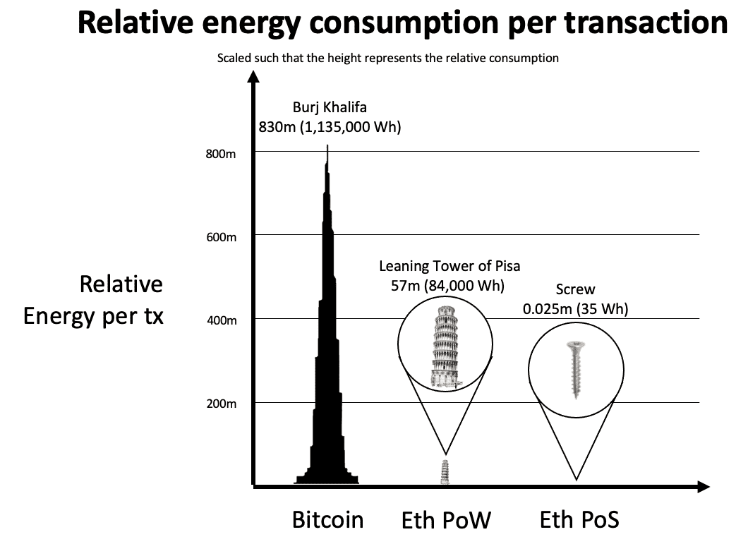
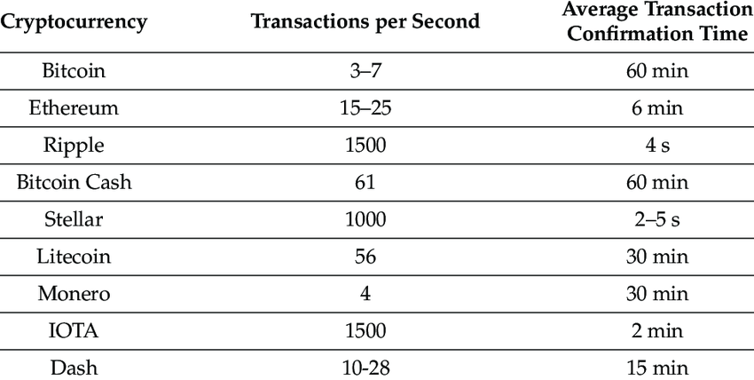
Proof-of-Work (PoW)
Advantages | Disadvantages
High level of security. | Inefficient with slow transaction speeds and expensive fees.
Provides a decentralized method of verifying transactions. | High energy usage.
Allows miners to earn crypto rewards. | Mining often requires expensive equipment.
Miners create mining pools to ramp up the required resources(to increase hash rate)- Making it centralized

Slide 54
Consensus Protocols
Consensus Protocols
Proof-of-Work (PoW)
Proof-of-Stake (PoS)
Others

Slide 55
Proof-of-Stake (PoS)
In PoW, multiple miners are competing against each other, but only one is getting rewarded.
There is a wastage of power by the nodes which are not winning.
This issue can be addressed, by selecting particular individuals to do the validation task instead of making them compete

Slide 56










Proof-of-Stake (PoS)
Choosing validator

Slide 57
Proof-of-Stake (PoS)
Choosing validator

Slide 58
Proof-of-Stake (PoS)
Choosing validator
Selected Validator

Slide 59
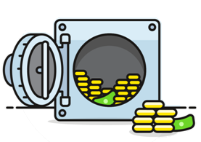

What is Stake?
100 Ethers as Stake (Security Deposit)
Stake > Transaction Fee

Slide 60
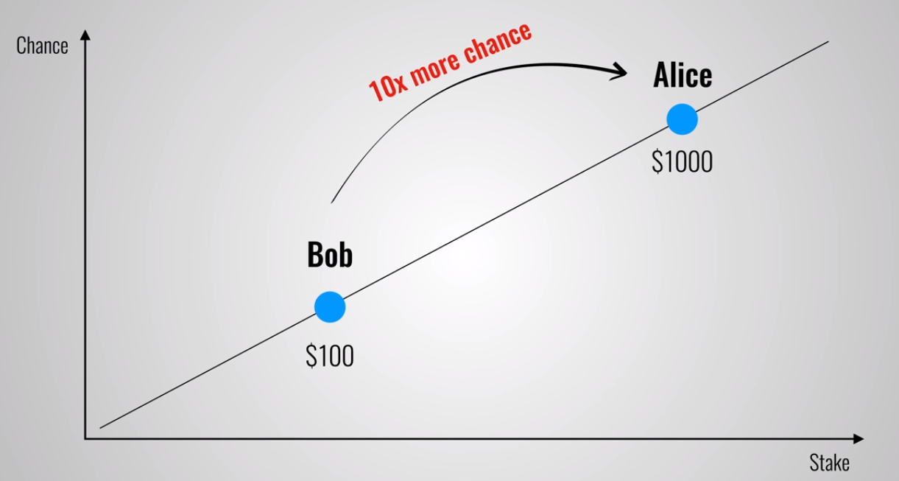
Probability of getting selected as validator
Biased towards rich?
No,
1KWh = $1
1000 KWh = $ 800 (not $1000) (non linear growth)
Rich have more advantage in PoW.

Slide 61
Validation and Block addition
Validate Genuine Transaction
Stake + Transaction Fee
given to validator
Validate Fraudulent Transaction
A part of the Stake taken away
as penalty

Slide 62
PoW vs PoS
Proof of Work (PoW) | Proof of Stake (PoS)
The probability of mining a block is determined by how much computational work is done by miner. | The probability of validating a new block is determined by how large of a stake a person holds (how many coins they possess).
A reward is given to first miner to solve cryptographic puzzle of each block. | The validator do not receive a block reward instead they collect network fee as their reward.
To add each block to chain, miners must compete to solve difficult puzzles using their computer process power | There is no competition as block creator is .chosen by an algorithm based on user stake.
Hackers would need to have 51% of computation power to add malicious block. | Hackers would need to own 51% of all cryptocurrency on network, which is practically impossible.
Proof of work systems are less energy efficient and are less costly but more proven. | Proof of Stake systems are much more cost and energy efficient than POW systems but less proven.
Specialized equipment to optimize processing power. | Standard server grade unit is more than enough.
Initial investment to buy hardware. | Initial investment to buy stake and build reputation.
Bitcoin is most well known crypto with a Proof-of-Work consensus building algorithm which uses most well known proof-of-work function is called SHA256. | Some of cryptocurrencies that use different variants of proof-of-stake consensus are: EOS (EOS), Tezos (XTZ), Cardano (ADA), Cosmos (ATOM), Lisk (LSK).

Slide 63
References
https://tools.superdatascience.com/blockchain/hash
https://www.superdatascience.com/blockchain/
https://www.udemy.com/course/build-your-blockchain-az/
https://www.youtube.com/watch?v=M3EFi_POhps
https://www.geeksforgeeks.org/difference-between-proof-of-work-pow-and-proof-of-stake-pos-in-blockchain/
Notes:
Proof of History
Mining of per Block in Bitcoin (how much energy is required)
Platform of Bitcoin is only for bitcoin, Ethereum , solana etc allow development of apps on blockchain
Next Task:
Read about Etheruem
Demo version of Ethereum Blockchain network
Secure Communication using blockchain network
- if issues in secure comm. can be addressed by blockchain

